Slide 1
Unit 1: Introduction

Slide 2
Need of OS
A modern computer is a complex system and so It’s impossible for every application programmer to understand how all these thing work in detail.
Managing all these components and using them optimally is an exceedingly challenging job.
Therefore, OS is introduced to provide user programs with a better, simpler, cleaner model of the computer and handle all the resources.
User uses various kinds of OS depending on the type of system.

Slide 3
1.1. Operating System and Function
An Operating System (OS) is an interface between a computer user and computer hardware.
OS is a software which performs all the basic tasks like file management, memory management, process management, handling input and output, and controlling peripheral devices such as disk drives and printers.
In general, it is a program that acts as an interface between the user and the computer hardware and controls the execution of all kinds of programs.

Slide 4
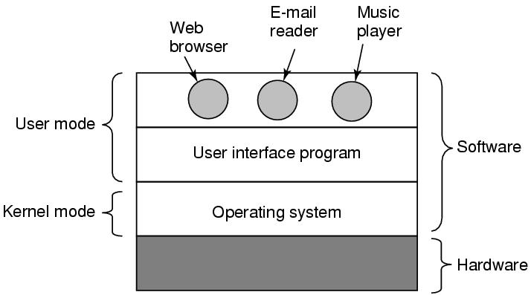
Operating System and Function

Slide 5
Functions of OS
Manages the allocation of main memory to specific jobs.
Manages the storage and retrieval of data from disks.
Manages input to the output from computer system.
Easy interaction between users and computers.
Invoking programming language translator programs when necessary.
Providing security to user jobs and files.
Maintain internal time clock and log off system usage for all users.

Slide 6
Functions of OS
Security − By means of password and similar other techniques, it prevents unauthorized access to programs and data.
Control over system performance − Recording delays between request for a service and response from the system.
Job accounting − Keeping track of time and resources used by various jobs and users.
Error detecting aids − Production of dumps, traces, error messages, and other debugging and error detecting aids.
Coordination between other softwares and users − Coordination and assignment of compilers, interpreters, assemblers and other software to the various users of the computer systems.

Slide 7
Views of OS
OS as resource manager
OS as extended machine

Slide 8
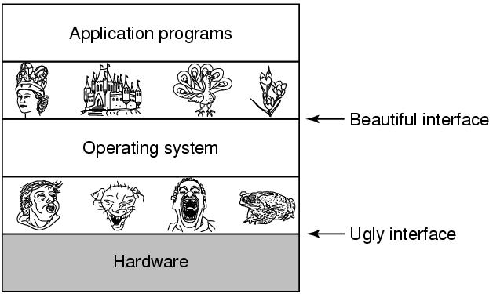
OS as resource manager and Extended machine

Slide 9
OS as resource manager
Allows multiple programs to run at the same time
Manage and protect memory, I/O devices, and other resources
Modern OS runs multiple programs of multiple users at the same time
  Imagine what would happen if several programs want to print at the same time?
  How to account the resource usage of each process?
  Resources can be multiplexed:
    How to ensure fairness and efficiency?

Slide 10
OS as Extended machine
Abstraction:
  CPU—process
  Storage –- files
  Memory– address space
4 types of people:
  Industrial engineer: design hardware
  Kernel designer
  Application programmer: OS’s user
  End users

Slide 11
1.2 Evolution of OS
The evolution of operating systems is directly dependent on the development of computer systems and how users use them.
Late 1950’s:-able to perform Single stream batch processing, use Common, standardized, input/output routines for device access, program transition capabilities to reduce the overhead of starting a new job was added, error recovery to clean up after a job terminated abnormally was added, etc.
In 1960s:-dawn of minicomputers, Compatible Time-Sharing System (CTSS), Burroughs Master Control Program (MCP), Minicomputers got cheaper, more powerful, and really useful, etc.

Slide 12
Evolution of OS
1970s:-Multi User and Multi tasking was introduced, Dynamic address translation hardware and Virtual machines came into picture, Modular architectures came into existence, Personal, interactive systems came into existence.
1971: Intel announces the microprocessor, 1972: IBM comes out with VM: the Virtual Machine Operating System, 1973: UNIX 4th Edition is published, 1974 The Personal Computer Age begins, 1976: Apple II, 1984 Apple Macintosh comes out, 1990 Microsoft Windows 3.0 comes out, 1991 GNU/Linux, 1993 Windows NT, 2008: Android OS

Slide 13
Evolution of OS
And as the research and development work continues, we are seeing new operating systems being developed and existing ones getting improved and modified to enhance the overall user experience, making operating systems fast and efficient like never before.
Also, with the onset of new devies like wearables, which includes, Smart Watches, Smart Glasses, VR gears etc, the demand for unconventional operating systems is also rising.

Slide 14
Types of Operating System
Batch system
Interactive system
Multiprocessing system
Time Sharing system
Real Time system

Slide 15
Batch Systems
There is no direct interaction between user and the computer.
The user has to submit a job (written on cards or tape) to a computer operator.
Then computer operator places a batch of several jobs on an input device.
Jobs are batched together by type of languages and requirement.
Then a special program, the monitor, manages the execution of each program in the batch.
The monitor is always in the main memory and available for execution.

Slide 16
Interactive system (Multiprogramming Batch system)
In this the operating system picks up and begins to execute one of the jobs from memory.
Once this job needs an I/O operation operating system switches to another job (CPU and OS always busy).
If several jobs are ready to run at the same time, then the system chooses which one to run through the process of CPU Scheduling.
In Non-multiprogrammed system, there are moments when CPU sits idle and does not do any work.
In Multiprogramming system, CPU will never be idle and keeps on processing.

Slide 17
Multiprocessing system
A Multiprocessor system consists of several processors that share a common physical memory.
Multiprocessor system provides higher computing power and speed
In multiprocessor system all processors operate under single operating system.
Multiplicity of the processors and how they do act together are transparent to the others.
Execution of several tasks by different processors concurrently, increases the system's throughput without speeding up the execution of a single task.

Slide 18
Time Sharing system
Time Sharing Systems are very similar to Multiprogramming batch system i.e, time sharing systems are an extension of multiprogramming systems.
In Time sharing systems the prime focus is on minimizing the response time, while in multiprogramming the prime focus is to maximize the CPU usage.

Slide 19
Real Time system
Operating system known to give maximum time for each of the critical operations that it performs, like OS calls and interrupt handling.
Response time is very less.
The RTOS, which guarantees the maximum time for critical operations and complete them on time are referred to as Hard Real-Time Operating Systems.
While the RTOS, that can only guarantee a maximum of the time, i.e. the critical task will get priority over other tasks, but no assurity of completeing it in a defined time. These systems are referred to as Soft Real-Time Operating Systems.

Slide 20
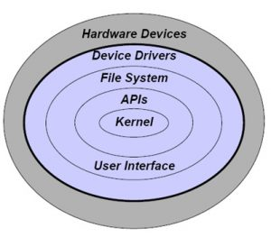
1.4 Operating system components

Slide 21
1.4 Operating system components
Kernel (main component of most OS, it acts as a bridge between applications and actual data processing done at hardware level)
System Calls (how a program requests a service from an OS’s kernel i.e to how to get kernel services)
Shell (Shell is a command interpreter that reads commands from a console/terminal)
Scheduler, memory manager, communication manager, thread manager, etc.

Slide 22
Model Questions.
Define OS. Explain OS as resource manager and extended machine.
What do you mean by kernel, system call, shell?

Slide 23
1.5 Operating System structure
Structures are OS models or framework that unites the many features and services the OS provides and task it performs.
Following are the structured mechanism of OS:
Monolithic System
Layered System
Micro Kernel system
Client server System
Virtual Machine

Slide 24
Monolithic System
Components are organized haphazardly and any module can call any other module without any reservation.
System code runs in kernel mode and applications run in user mode, with limited set of interfaces available and with limited access to system data.
Ex: MS-DOS, CP/M

Slide 25
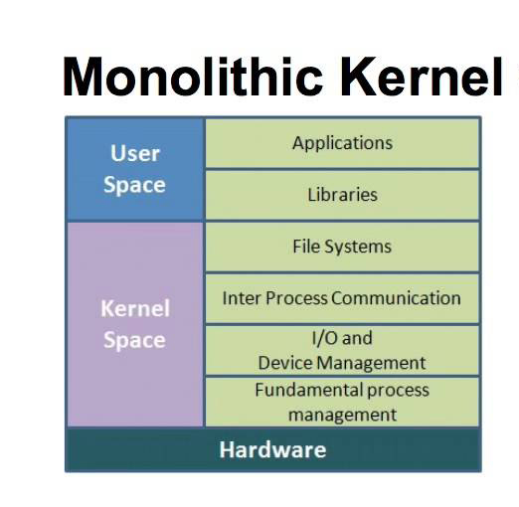
Monolithic System

Slide 26
Layered System
Breaks the OS into number of layers (level) built upon the top of lower layers.
The bottom layer is the hardware layer and the highest layer is the user interface.
Simplifies debugging system and provides modularity.
Ex: The OS

Slide 27
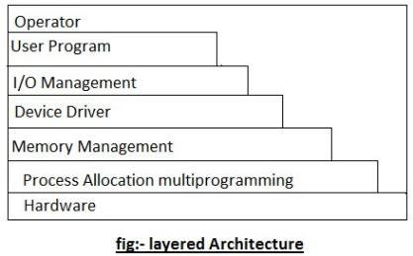
Layered Systems

Slide 28
Microkernel System
The idea behind the microkernel is to achieve high reliability.
It splits the OS into small, well defined modules, only one of which the microkernel runs in kernel mode and the rest runs as relatively powerless ordinary user process.
Reliability, Fault tolerance, replications, heterogeneity, etc. are the main design issues in microkernel.

Slide 29
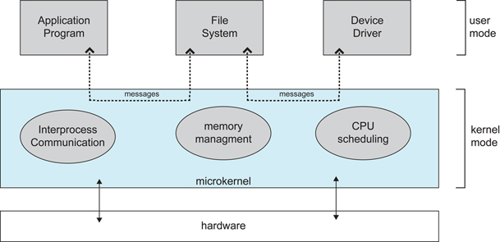
Microkernel

Slide 30
Client Server System
Here the client which can be either another OS component or application program, request a service by sending messages to the server. (Request)
An OS kernel (Microkernel) running in kernel mode delivers the message to the appropriate server.
The server performs the operation and microkernel delivers the result to the client in another message. (Reply)

Slide 31
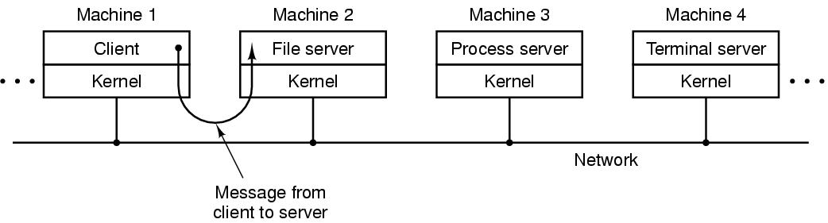
Client-Server Model

Slide 32
Virtual Machine
This approach provides an interface that is identical to the underlying bare hardware i.e. provides exact duplicate of the underlying machine.
Each process is provided with the (virtual) copy of the underlying computer (as shown in figure b, in next slide).
Difficult to implement .
Ex: JAVA VM.

Slide 33
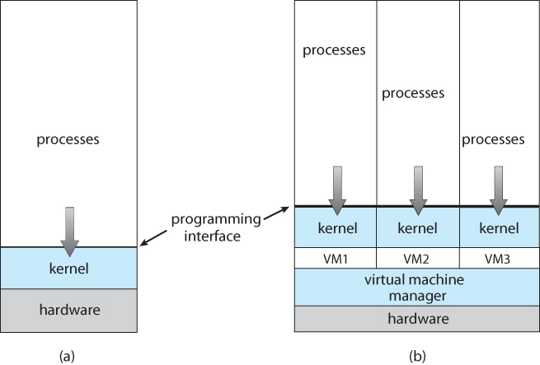
Virtual Machine
Non Virtual Machine
Virtual Machine

Slide 34
1.6 Operating System Services
System Calls
Shell Commands
Shell Programming

Slide 35
System Calls
System call is how a program requests a service from an OS’s kernel.
This may include hardware related services (ex. Accessing Hard disk), creating and executing new process, communication between processes, etc.
System call provides the interface between process and OS.
It can be grouped into many categories such as:
Process Control (load, execute, create, terminate, allocate, free, get or set sttributes, wait, etc)
File management (create, delete, open, close,read/write, get/set file attributes)

Slide 36
System Calls
3. Device management (request device, release device, read, write, reposition, get/set device attributes)
4. Communication (create/delete communication, send/receive messages, transfer status information, attach/detach remote devices)
5. Information maintenance (get/set time or date, get/set system data, get/set process, file or device attributes)

Slide 37
Shell commands
Shell is a command interpreter that reads commands from console/terminal.
It is the outer layer of the OS and is a interface between user and internal part of OS.
A user is in shell (i.e interacting with the shell) as soon as the user has logged into the system.
There are thousand of commands available for the command line user.

Slide 38
Shell Programming
Works as scripting language interpreter.
With thousands of commands available for the command line user, we also use the power of the shell to automate things for which we write shell scripts which is called shell programming.
A shell script is a file containing a series of commands.
The shell reads this file and carries out commands as though they have been entered directly on command line.
Shell script may assign values to shell variables and then read them later.
They may also have parameters and use if, for, while and case constructs.
Shell script is really a program written in c language.

Slide 39
Examples of OS
UNIX
LINUX
MS-Windows
Handheld OS
Mach OS
etc.

